Slide 1
MINERAL SWIM
Testing & chemical impact

Slide 2
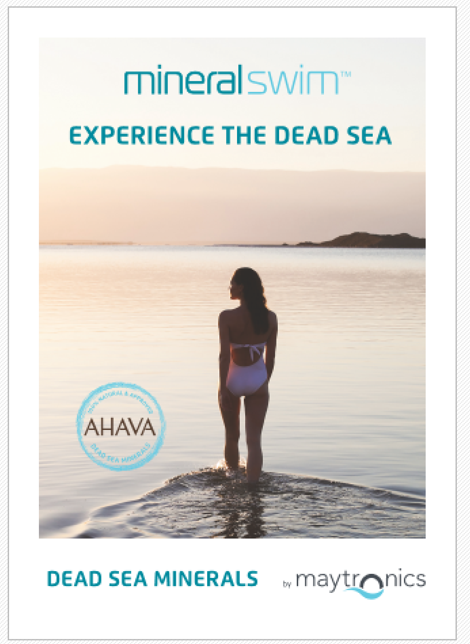

System Structure
Dealer Pilot
Current AHAVA Point of Sale Collateral
Nature and science should sustainably work in balance…

Slide 3
Overview
Builder Range - Pilot
Current AHAVA Stock
Overview
A MineralSwim pool should be treated the same as a normal Salt pool for testing methodologies except as noted below.
A correctly balanced MineralSwim pool will provide for improved pool control as well as a unique bather experience.
DIFFERENCES TO A STANDARD SALT POOL…..
pH
Hardness
TDS

Slide 4
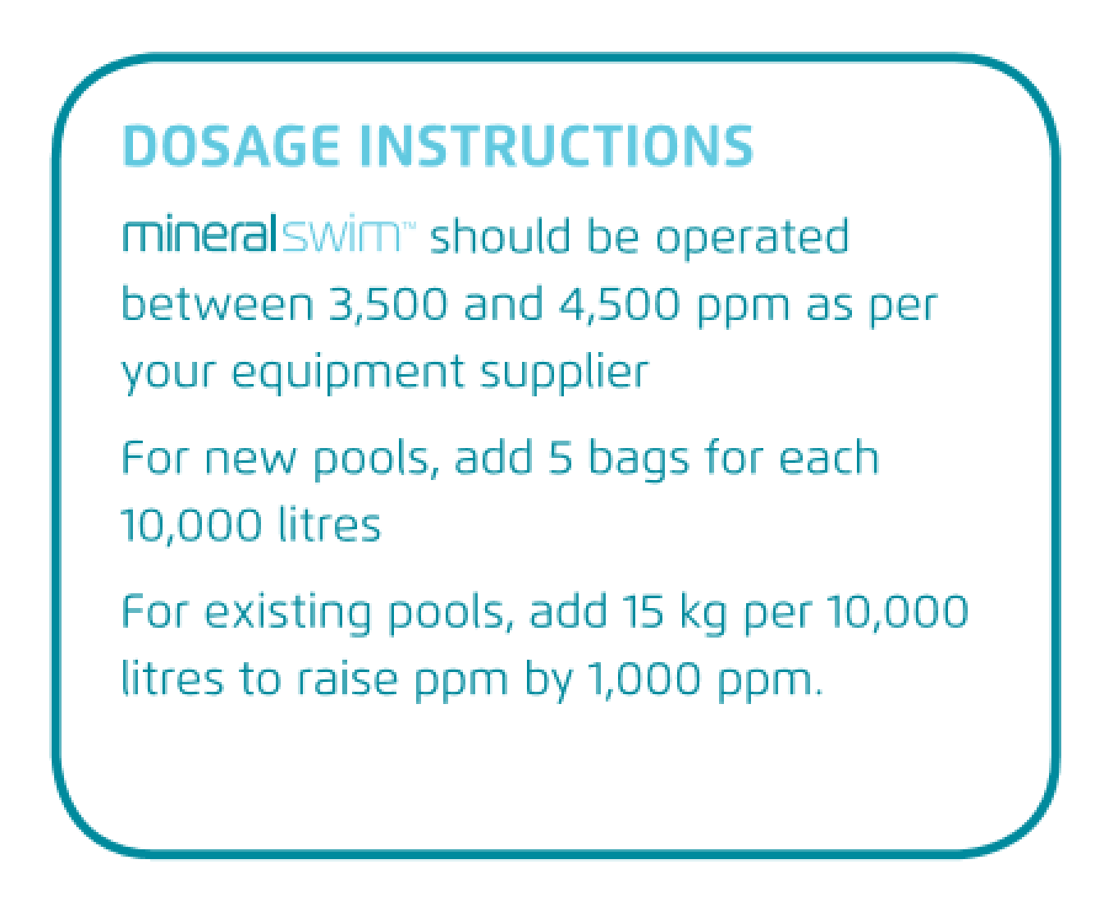
TDS
A measure of the Mineral Content in the water
Includes all dissolved solids, not just minerals
A MineralSwim Pool should be operated between
3,500 – 4,500 ppm
Steps:
  Measure TDS
  Top up with required minerals
Eg.:
  TDS in a 20,000 litre pool measured as 2500ppm
  Add 2 bags to raise to 3500 ppm
  OR
  Add 4 bags to raise to 4500 ppm

Slide 5
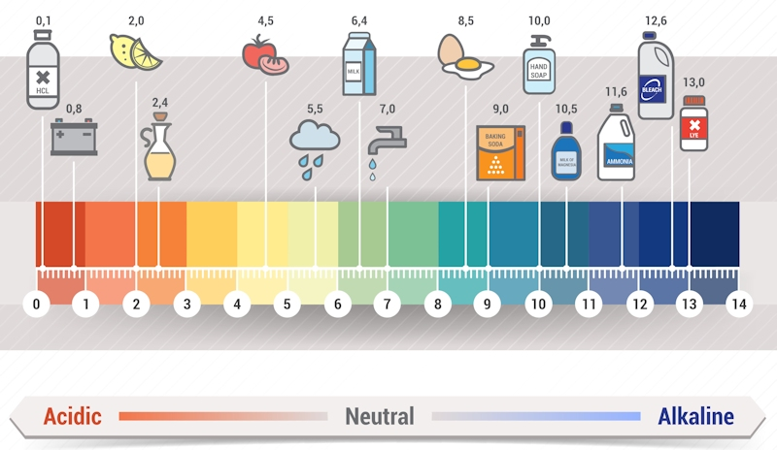
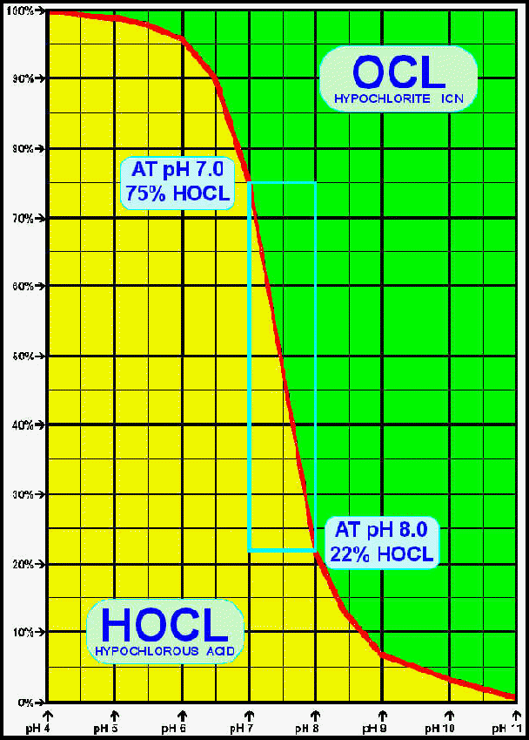
pH
Normal pH measurement is used for a MineralSwim Pool
Normal pH adjustment is used for a MineralSwim Pool
Normal pH range (7.2 – 7.6) should be used for a MineralSwim Pool
Saltwater & Mineral Pool systems drive the pH up as a side-effect of the process undertaken in the cell.
OzoneSwim reduces the chlorine demand
  enabling the cell to work less
  thereby reducing the pH increasing effect of using the cell for as long a period or at as high an output level.

Slide 6
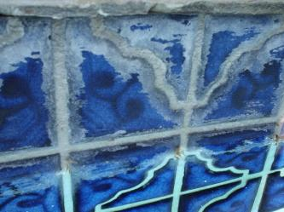
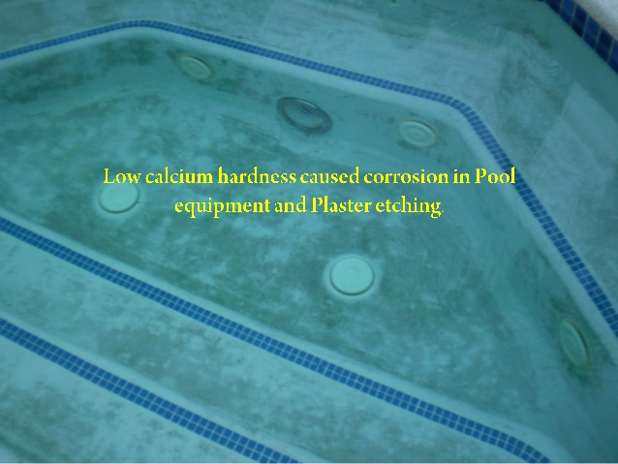
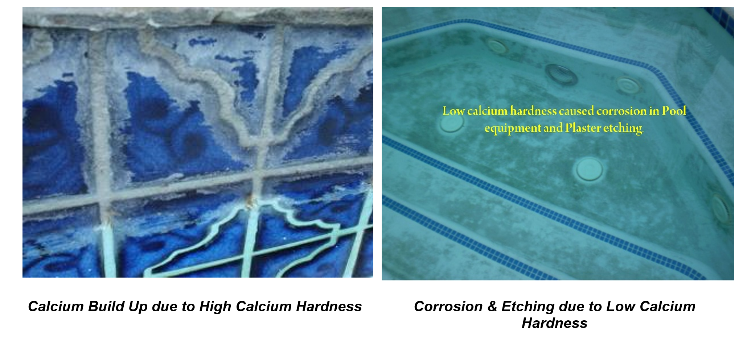
Total Hardness & Calcium Hardness
This is the biggest difference in testing and pool management
The testing is used to determine the balance between the calcium in the pool water and the calcium in the pool surface.
Very important for Concrete pools – because the grout and concrete is calcium based.
Pool manufacturer / pool surface supplier will normally have a recommended Calcium Hardness range
Impact:

Slide 7
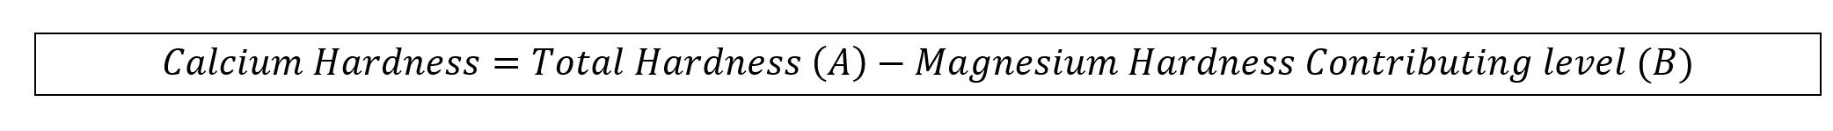
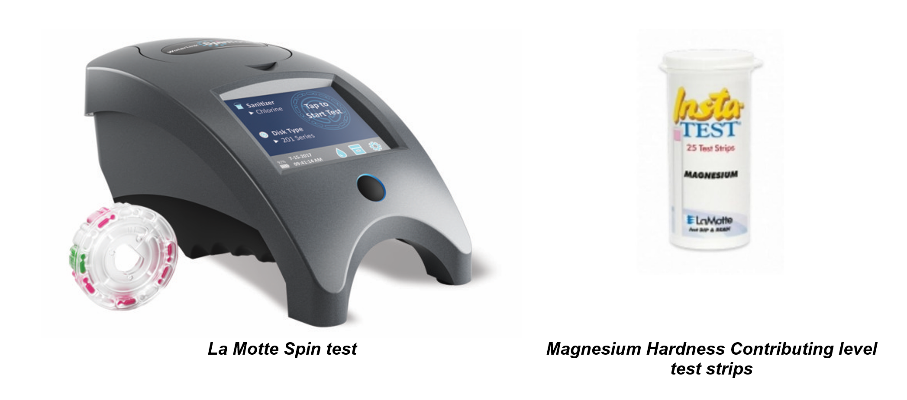
Total Hardness & Calcium Hardness
  Test methodology:
    Measure the Total Hardness (A) – using either Spin test or test strips.
    Measure the Magnesium Hardness contributing Level (B) – using La Motte test strips
Adjust using normal Calcium Hardness chemicals

Slide 8
Summary
Builder Range - Pilot
Current AHAVA Stock
A MineralSwim pool should be treated the same as a normal Salt pool for testing methodologies except as noted below.
A correctly balanced MineralSwim pool will provide for improved pool control as well as a unique bather experience.
DIFFERENCES TO A STANDARD SALT POOL…..
pH
Hardness
TDS

